Slide 2
Defining and Measuring the Social Impact of Clean Cooking Solutions March 16, 2015

Slide 3
What we will cover today:
The objectives & purpose of creating a global measurement system
The process of developing the conceptual frameworks
Conceptual frameworks
→ Feedback
Draft indicators & measurement methodologies
Next steps

Slide 4
Social Impact M&E Needed at Three Levels
1) Social impact conceptual framework for the sector overall – telling a global story
What information do we want from all partners to demonstrate the sector has a social impact?
Suggestions include economic status of household/poverty reduction, time savings, livelihoods created.
Potentially utilize Progress out of Poverty Index for poverty measurements.
2) Social impact M&E indicators, methodologies, and tools to measure and track a limited number of social impact areas at the enterprise/project level.
Set of indicators & methodologies
Guidance for implementation
Results reporting and certification
3) Strategy for M&E deep dive impact evaluations in certain areas.
Areas where specific impact evaluations are needed to fill data gaps and get a more robust picture. For example, the Alliance research studies looking at impact of adoption on households in areas of empowerment, time savings, education, decision-making, etc.

Slide 5
Process for Defining, Measuring and Reporting on Social Impact
Objectives:
Gain consensus on the main domains and pathways through which the clean cooking sector creates social impact
Create a collection of standardized indicators & measurement methodologies
Create a centralized data capture, management, and analysis system
Why?
To allow partners to track and analyze progress
To aggregate the social impact of the clean cooking sector at a global level
How?
Map and define relevant social impacts
Select key domains of social impact for measurement
Draft indicators
Select/create measurement methodologies
Develop a data capture and management system
Pilot M&E system
Modify and adjust
Roll out
ICRW Phase 1

Slide 6
Why ICRW wanted to engage in this work:
Objectives:
Gain consensus on the main domains and pathways through which the clean cooking sector creates social impact
Create a collection of standardized indicators & measurement methodologies
Create a centralized data capture, management, and analysis system
Why?
To allow partners to track and analyze progress
To aggregate the social impact of the clean cooking sector at a global level
How?
Map and define relevant social impacts
Select key domains of social impact for measurement
Draft indicators
Select/create measurement methodologies
Develop a data capture and management system
Pilot M&E system
Modify and adjust
Roll out

Slide 7
Social Impact Conceptual Framework: How involvement in the clean cooking value chain expands livelihoods opportunities for women and men
Involvement through the Clean Cooking Value Chain
Components of Enhanced Livelihoods
Outcomes of Expanded Livelihood Opportunities
Ultimate Goal
Investors
Employment
SME owners & executives
Quality employment and/ or entrepreneurship opportunities
Increased income
Increased knowledge & skills
Increased access to resources
Enhanced social capital through expanded networks
Income
Selection & design of clean cooking products
Technical & business skills
Enhanced economic well-being
Production of clean fuels and/or stoves
Business & social networks
Distribution of clean fuels and/or stoves
Knowledge of environmental/ health benefits
After-sales service of clean stoves
Adoption of clean cooking solutions
Borrowers (supply-side)
Expanded access to capital/credit
Financing options for consumers

Slide 8
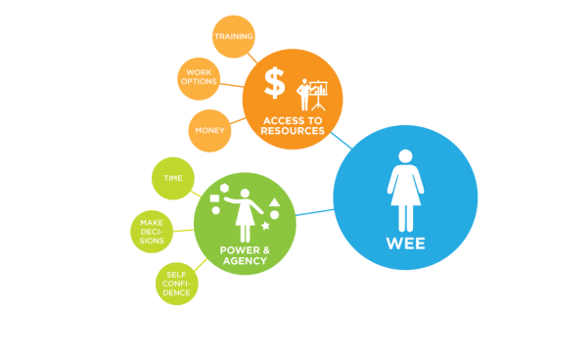
Women’s Economic Empowerment
Structures & Institutions
Relations
Safety
Health
Voice
Source: ICRW (2011). Understanding and Measuring Women’s Economic Empowerment: Definition, Framework and Indicators. Graph: MarketShare Associates (2014)
Notes:
A woman is economically empowered when she has both the ability to succeed and advance economically and the power to make and act on economic decisions.
To succeed and advance economically, women need the skills and resources to compete in markets, as well as fair and equal access to economic institutions.
To have the power and agency to benefit from economic activities, women need to have the ability to make and act on decisions and control resources and profits.
These concepts of economic advancement and power & agency are iterative and build off of each other

Slide 9
Defining WEE
A woman is economically empowered when she has both the ability:
To succeed and advance economically
women need the skills and resources to compete in markets, as well as fair and equal access to economic institutions
To have the power and agency to benefit from economic activities
women need to have the ability to make and act on decisions and control resources and profits

Slide 10
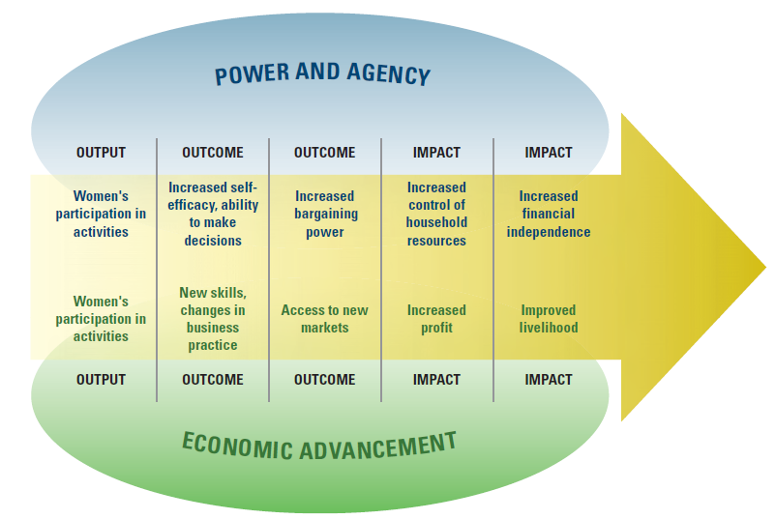
Measuring Women’s Economic Empowerment
Notes:
Measuring women’s economic empowerment requires considering indicators of both women’s economic advancement and women’s power and agency

Slide 11
Social Impact Conceptual Framework: How involvement of women in the clean cooking value chain enhances women’s social and economic empowerment
Involvement of Women
Components of Empowerment
Outcomes of Empowerment
Ultimate Goal
Women investors
Employment
Women SME owners & executives
Income
Enhanced voice/ participation
Improved self-confidence & self-efficacy
Increased decision-making and control over resources
Improved status
Women in selection & design of clean cooking products
Technical & business skills
Women’s enhanced social & economic empowerment
Women in production of clean fuels and/or stoves
Business & social networks
Women in distribution of clean fuels and/or stoves
Agency
Knowledge of environmental/ health benefits
Women in after-sales service of clean stoves
Multiplier Effect
Adoption of clean cooking solutions
Expanded access to capital/credit
Women as borrowers (supply-side)
Financing options targeted to women as consumers

Slide 12
Social Impact Conceptual Framework: How adoption of clean cooking solutions translates into improvements in households’ social & economic well-being
Primary
Outcomes
Secondary Outcomes
Ultimate Outcomes
Money spent on fuel
Shifts in Household Finances
Increased financial security/income
Money earned using clean cookstove/fuel
Increased time spent on income- generating activities
Enhanced social and economic well-being
Adoption of clean cooking solutions
Time spent cooking
Increased time spent on informal, non-income generating activities
Shifts in Time Use
Time spent collecting fuel
Increased time spent on leisure activities
Increased time spent on education/ training (adult/children)
Reduced drudgery
(time & heaviness of load)
Shifts in Workload
Length/frequency of fuel collecting trips
Enhanced safety/protection (reduced exposure to potential injury, GBV)
Health benefits
(reduced smoke exposure, lower rates of accidents/burns)
Health benefits

Slide 13
Livelihoods | Jobs
 | Income full-time/ part-time or Permanent/annual & temporary/ seasonal
 | Income management
 | Quality of jobs created
 |  | Full-time/ part-time
 |  | Permanent/ temporary
 |  | Management level
 |  | Area within the value chain
 |  | Geographic location
 |  | Women-owned
 | Interaction with external organizations and entrepreneurs
 | Mentoring
 | Business skills
 | Empowerment/leadership skills
 | Access to networks
 | Access to credit
 | Agency
 |  | Decision-making & control over resources/ assets
 |  | Self-confidence/ self-efficacy
Notes:
Studies show that mentoring in a critical component in creating successful entrepreneurs. This is especially true for female entrepreneurs who may otherwise lack access to a support network and outside resources. Due to the fact that research has shown the benefits of mentoring, simply knowing whether the individual had received mentoring should provide valuable information. However, the enterprise could also track additional indicators related to the quality of the mentorship and whether it is actually making employees and entrepreneurs more effective.
For this indicator, we would need to clearly define what activities constitute "mentoring". If this question is asked through a survey, we may want to include other qualitative data related to the mentoring experience and benefits experienced.

Slide 14
Income slide
Income full-time/ part-time or Permanent/annual & temporary/ seasonal | Average income of female full-time employees (non-management)
 | Average income of male full-time employees (non-management)
 | Average income of female part-time employees (non-management)
 | Average income of male part-time employees (non-management)

Slide 15
Agency
 | Decision-making & control over resources/ assets | Percentage of respondents who have recently participated in business expenditure decisions (disaggregated by males/females)
 |  |  | Average level of satisfaction with ability to make business expenditure decisions (disaggregated by males/females)
 |  | Percentage of respondents who have recently participated in household expenditure decisions
 |  |  | Average level of satisfaction with ability to make decisions about household expenditures (disaggregated by males/females)
 |  | Average level of satisfaction with ability to make important life decisions (disaggregated by males/females)
 | Self-confidence/ self-efficacy | OPTION 1: Average sense of autonomy felt by employees/ entrepreneurs (disaggregated by males/females)
 |  | OPTION 2: Average sense of agency (i.e. goal-directed energy) among employees/ entrepreneurs (disaggregated by males/females)
 |  | OPTION 2: Average sense of knowing the pathway to accomplishing one's goal among employees/ entrepreneurs (disaggregated by males/females)

Slide 16
Household Finances | Money spent on fuel | Average change in money spent on fuel per household that obtains new clean cooking solutions technology/units
 |  |  | Total change in amount of money spent on fuel in households that adopt clean cooking solutions
 | Income through productive use of cookstove | Percentage of consumers who are using the cookstove for income generation
 |  |  | Percentage of those using the cookstove for income generation who are female
 |  | Average income earned by those using the cookstove for income generation
 |  |  | Average income earned by females using the cookstove for income generation
 | Economic stability | OPTION 1: Percentage of people who report a positive change in their level of satisfaction with their standard of living (disaggregated by males/females)
 |  | OPTION 2: Percentage of people who report improvements in their perception of economic stability (disaggregated by males/females)

Slide 17
Time Use | Time spent on fuel collection | Average change in number of hours spent on fuel collection (per household and/or disaggregated by men, women, boys, girls)
 |  |  | Total change in number of hours spent on fuel collection (per household and/or disaggregated by men, women, boys, girls)
 | Time spent on cooking | Average change in number of hours spent on cooking (per household and/or disaggregated by men, women, boys, girls)
 |  |  | Total change in number of hours spent on cooking (per household and/or disaggregated by men, women, boys, girls)

Slide 18
Household Social & Economic Well-being | Well-being |  | OPTION 1: Percentage of people who perceive a positive change in their well-being after using the clean cooking solutions (disaggregated by males/females)
 |  |  | OPTION 2: Percentage of people who experienced a positive change in overall satisfaction score. (disaggregated by males/females)
 |  |  |  | Average change in satisfaction score (disaggregated by males/females)
 | Status within the family/community |  | OPTION 1: Percentage of people who report a positive change in their perception of their own status within the family/ community (disaggregated by males/females)
 |  |  | OPTION 2: Percentage of people who experienced a positive change in their level of satisfaction with their status in their family and community (disaggregated by males/females)
 | Workload
 |  | Safety/protection | OPTION 1: Percentage of people who report a positive change in their perception of their exposure to risk (disaggregated by males/females)
 |  |  | OPTION 2: Percentage of people who experience a positive change in their level of satisfaction with their sense of safety in their community (disaggregated by males/females)
 |  | Drudgery | OPTION 1: Percentage of people who report a positive change in their perception of their level of drudgery/workload (disaggregated by males/females)
 |  |  | OPTION 2: Percentage of people who experienced a positive change in their level of satisfaction with their level of drudgery/workload (disaggregated by males/females)

